Slide 1
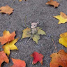
Iowa Liquor sale Explorer
Strategic Sales Recommendations

Slide 2
Group members
Behnaz Salehipourshirazi
Fangji Chen
Mikhail Mishenin
Oluwadamilare Shiji
Qin Ren
Namood E Sehar

Slide 3
Strategic Insights by Apex Market Dynamics
Welcome, I represent Apex Market Dynamics, a leading consultancy firm dedicated to transforming data into growth opportunities. With a focus on the liquor industry, we've propelled market share expansion and optimized sales strategies for our partners. Our commitment is to excellence and innovation, where we turn challenges into triumphs.
Over the years, our expertise has contributed to substantial market share growth across various sectors. We've had the privilege of fostering long-term relationships with esteemed clients, consistently delivering results that exceed expectations.

Slide 4





A Partnership Forged in Excellence
Global Spirits United: A conglomerate for whom we've maximized international market penetration.
Sapphire Distilleries: High-end spirits producer with increased brand prestige from our market positioning strategies.
BrewCraft Innovations: Craft beer specialists with an expanded distribution network due to our targeted campaigns.
Majestic Hotel Group: Luxury hospitality provider with a bespoke beverage program curating a unique guest experience.
Vintage Vine Retail: A premier chain of liquor stores now leading sales in the midwestern region.

Slide 5
Navigating Today's Market Landscape
Today's presentation revolves around a critical theme – Adapting and Thriving in a Shifting Market.
We will delve into actionable insights drawn from Iowa's liquor sales data, exploring market trends, consumer behavior, and strategic recommendations. Our goal is to equip you with the knowledge and tools needed to emerge stronger in a post-pandemic marketplace.

Slide 6

The pandemic and marketing impact

Slide 7

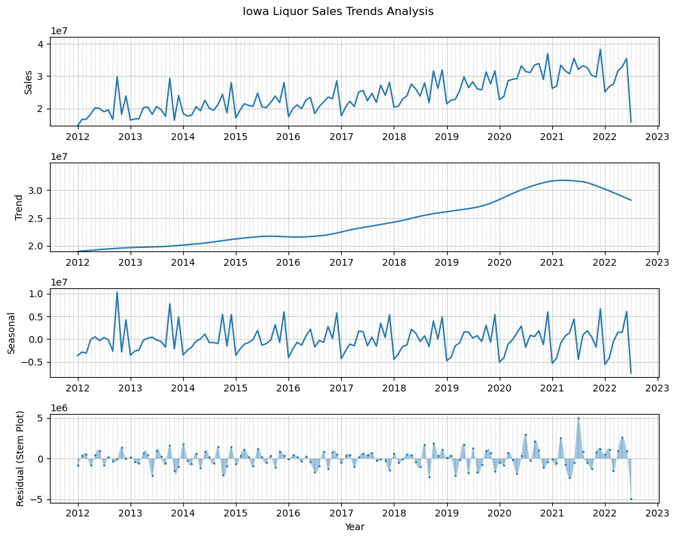
The Unprecedented Challenge
In the face of the ongoing pandemic, the liquor sales industry has encountered unforeseen challenges. The landscape of sales has been reshaped by changing regulations, consumer habits, and economic pressures.
As we see from our latest data, the trend has taken a dip, reflecting the harsh impact of COVID-19 with no immediate end in sight.

Slide 8
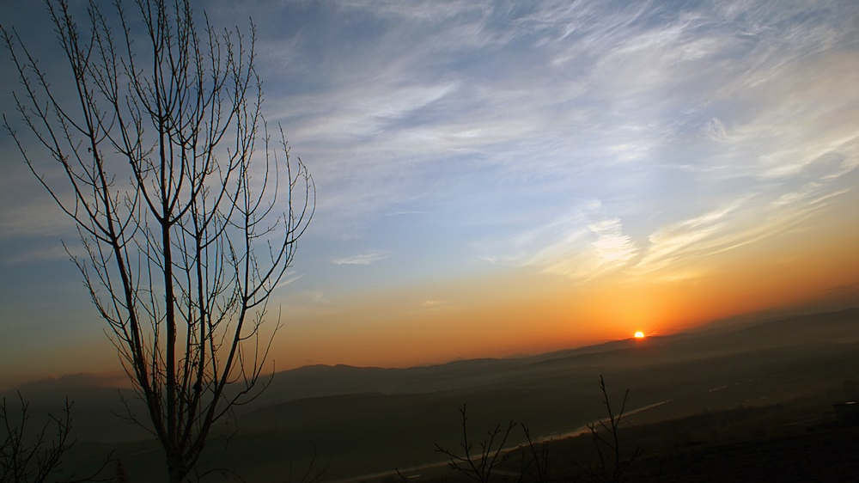
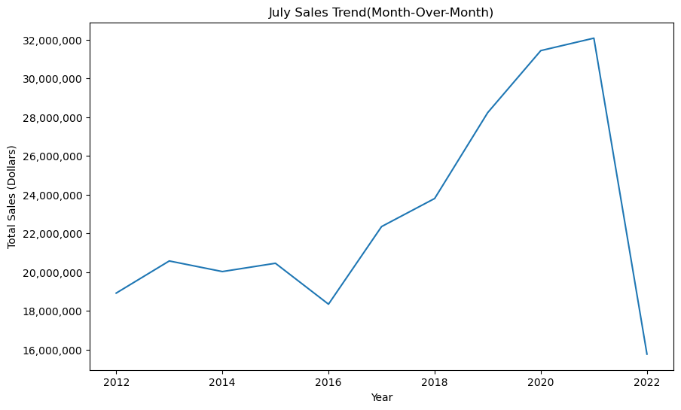
Harnessing Resilience for a Brighter Tomorrow
However, it's crucial to remember the robust growth we've witnessed in the pre-pandemic years. This downtrend is a bend, not the end.
As history has shown, the market holds pent-up demand that is likely to surge post-pandemic. Let's prepare to capture the rebound and accelerate into a future where the potential for liquor sales is vast and promising.

Slide 9

Rememorize

Slide 10


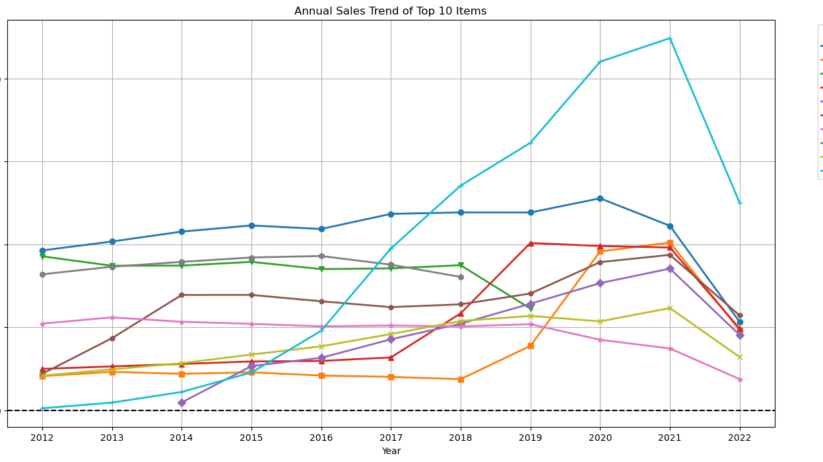
Turning the Page: From Challenge to Opportunity
Acknowledge the market's hardships and industry impacts
Remember the robust pre-pandemic market dynamics
Let go of the old playbook — embrace change
Post-pandemic: A time for growth and seizing new opportunities

Slide 11

adaptation

Slide 12
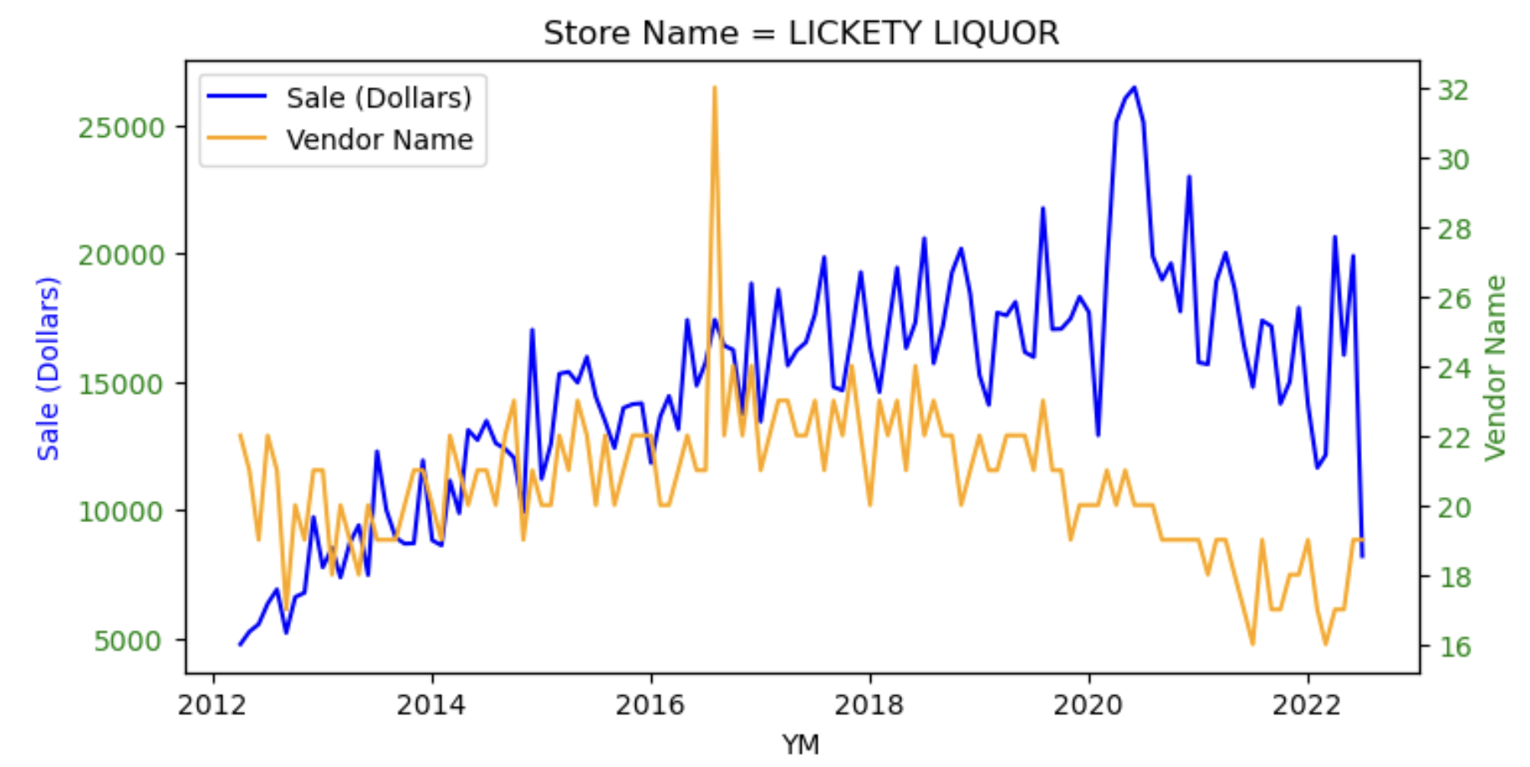
Strategic Alliances with Suppliers
A decline in supplier diversity can lead to a reduced variety of offerings, impacting our ability to meet customer needs. This can result in customer attrition and ultimately affect our bottom line.
It is crucial to build a resilient supply chain that can withstand market fluctuations and maintain product diversity to meet our customers' needs.

Slide 13
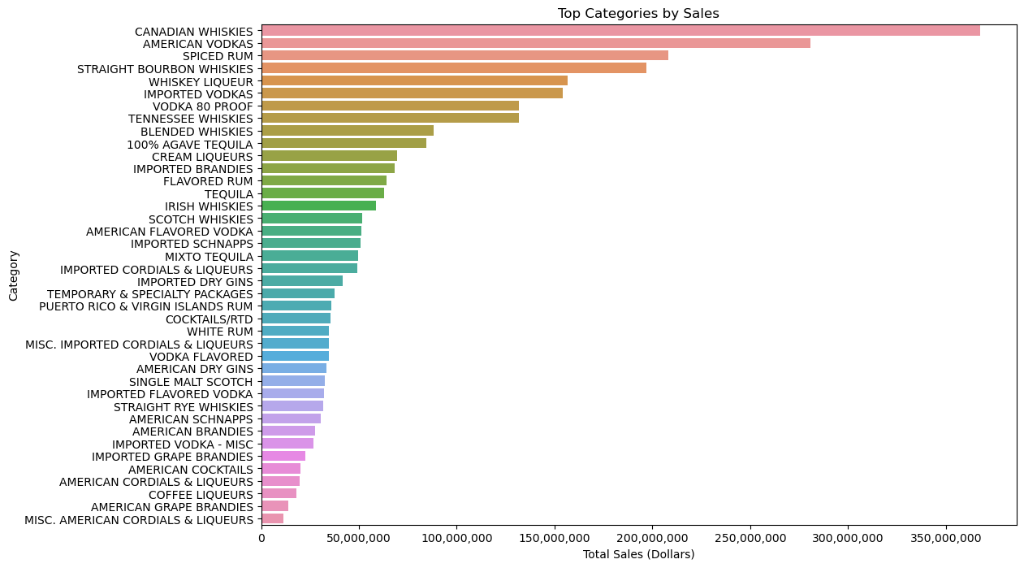
Spectrum of Sales Across Categories
Canadian whiskies and American vodkas lead the way, indicating their strong market presence. Understanding these preferences informs our strategy to prioritize stock and tailor promotions.

Slide 14
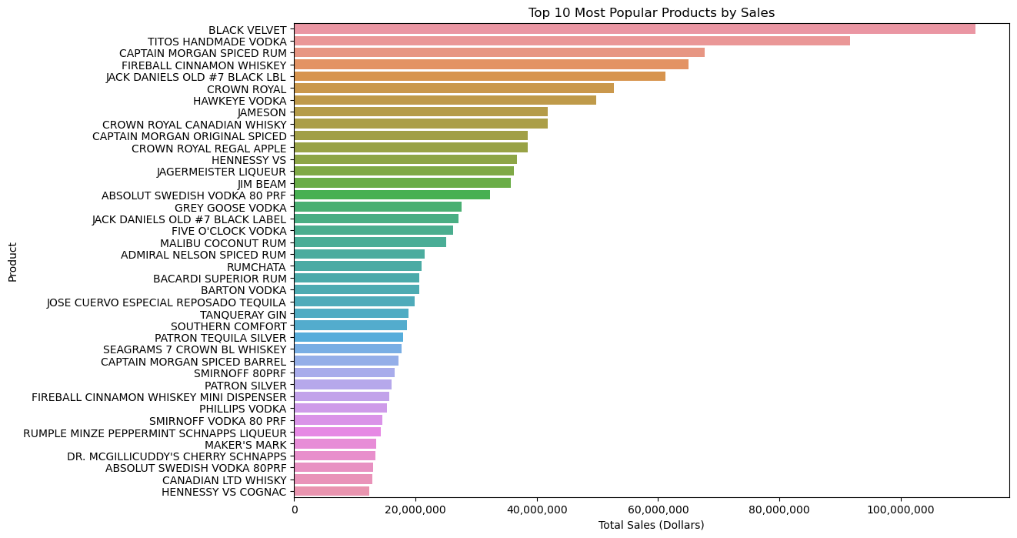
Top Performers products
Driving our sales and shaping market trends, staying attuned to these preferences ensures our offerings align with consumer desires.

Slide 15
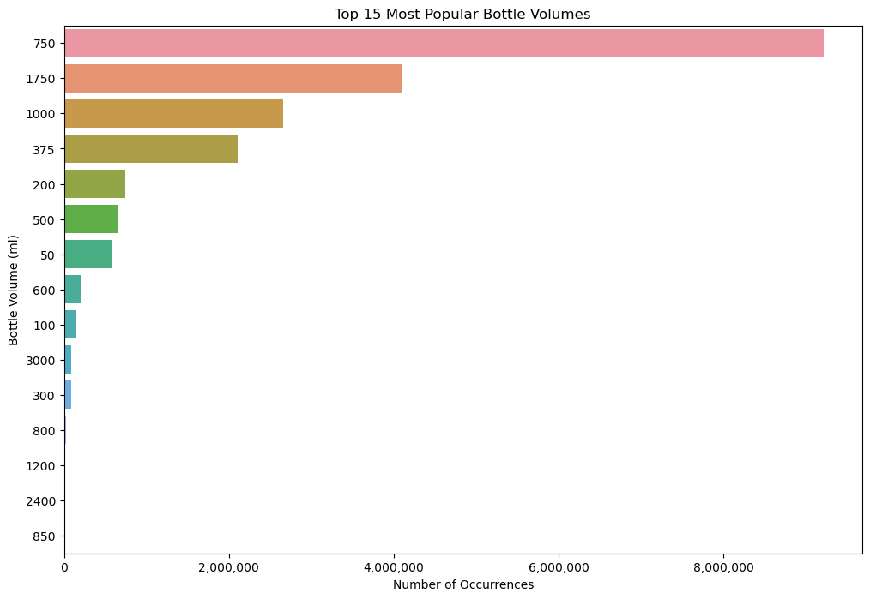
Popular Bottle Sizes in Demand
Which bottle is the most favorite among all choices? This plot reveals consumer purchasing patterns, with the 750ml bottle leading in popularity.
Understanding these patterns allows us to optimize our inventory to better match consumer buying habits. The focus on stocking preferred sizes ensures we meet market demand efficiently.

Slide 16
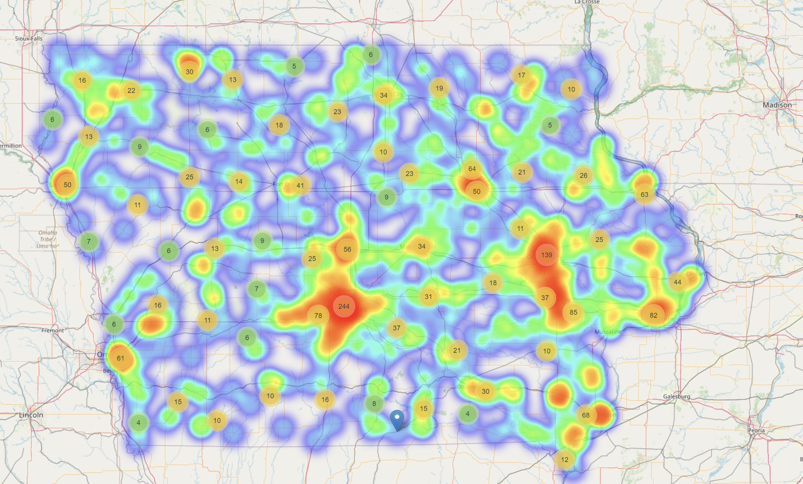
potential hotspots for retail expansion
Areas ripe for investment and untapped markets. Out suggestion is to open new stores near these two hot spots city.
Our analysis suggests that strategic store placements within these locations could maximize our reach and leverage the momentum of economic recovery.

Slide 17
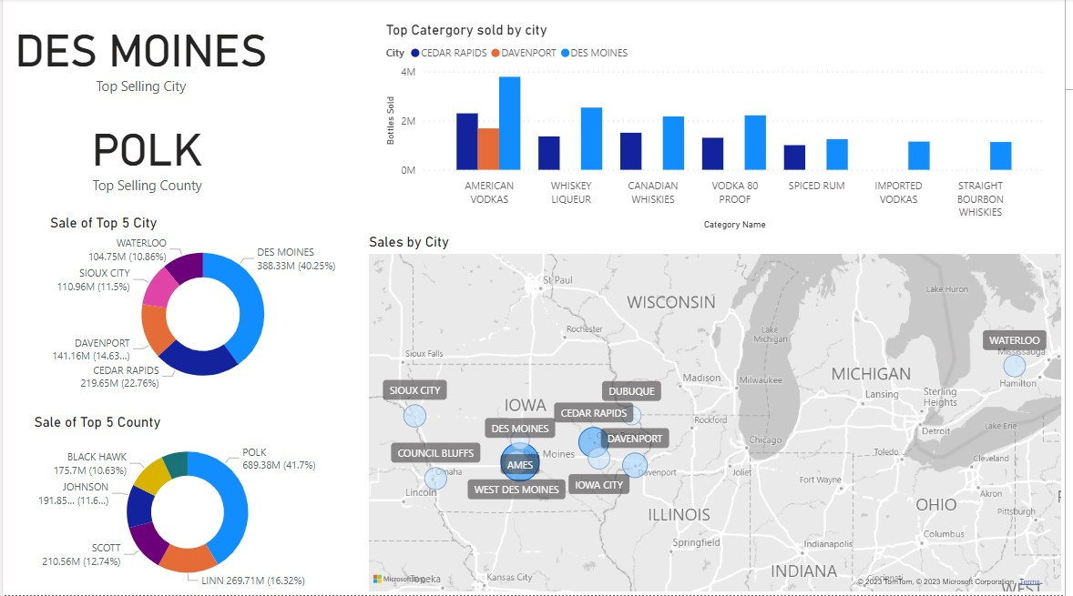
Strategic Expansion: Targeting Untapped Markets
Where lies our next opportunity for market expansion? Here are the sales distribution among the top 5 cities and counties, suggesting areas with room for growth. Des Moines is the top-selling city and Polk is the top-selling county
Drawing attention to their significant market share!
Our analysis indicates a strong market presence in Des Moines and Polk county, with significant sales in American Vodkas and Whiskey Liqueurs.
To continue our growth, we should explore adjacent areas with lower market saturation, leveraging our understanding of category preferences to meet untapped customer demand.

Slide 18
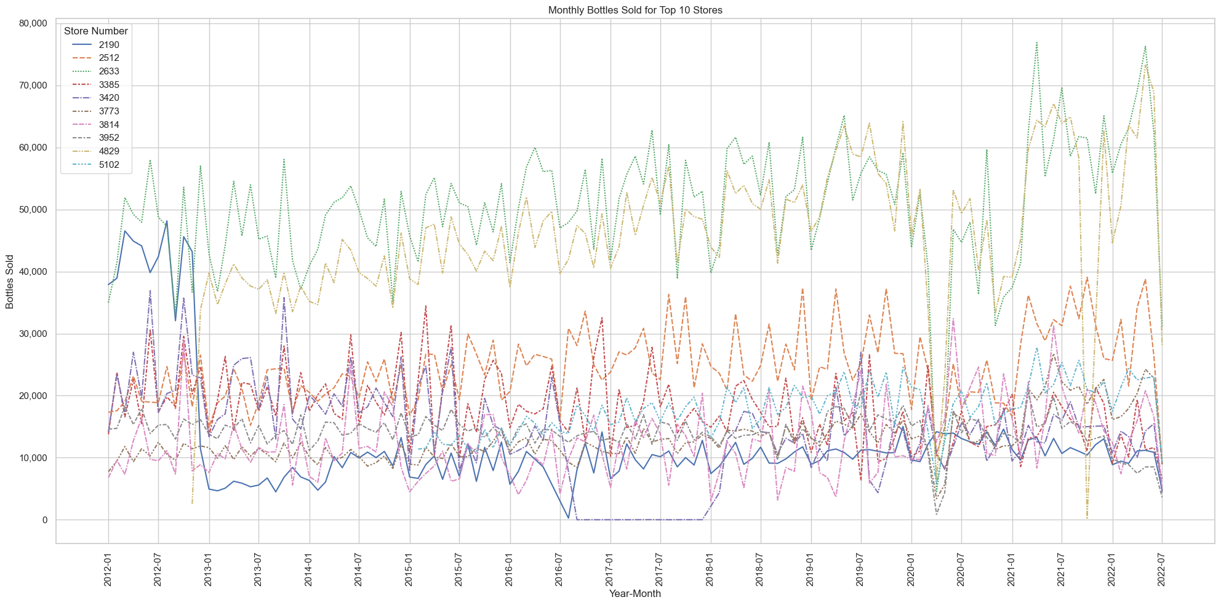
Don’t underestimate your competitors
These retail giants in the liquor industry have built a robust customer loyalty and exhibit exceptional management skills, remaining resilient in the face of the pandemic.
When considering new store locations, it's prudent to strategically distance ourselves from these established players to carve out our unique market space.

Slide 19
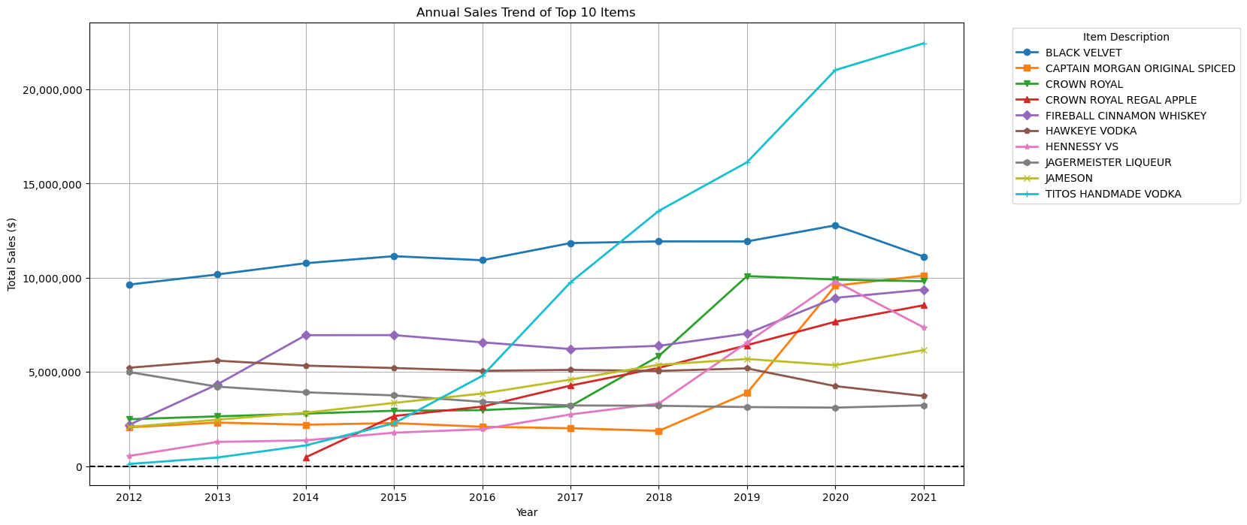
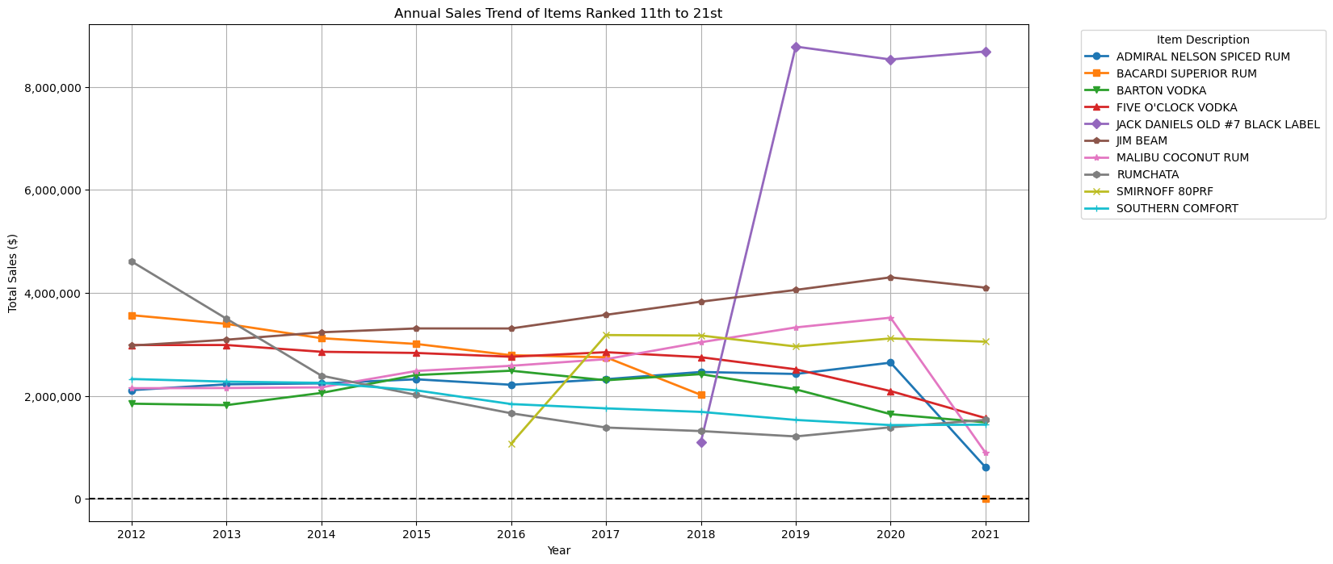
Adapting to Evolving Market Demands
As market preferences shift, our ability to quickly respond and cater to these changes is key. The sales trends of our top-selling items reflect the dynamic nature of consumer interests. Staying ahead requires vigilance and a readiness to meet demand where it's headed.

Slide 20
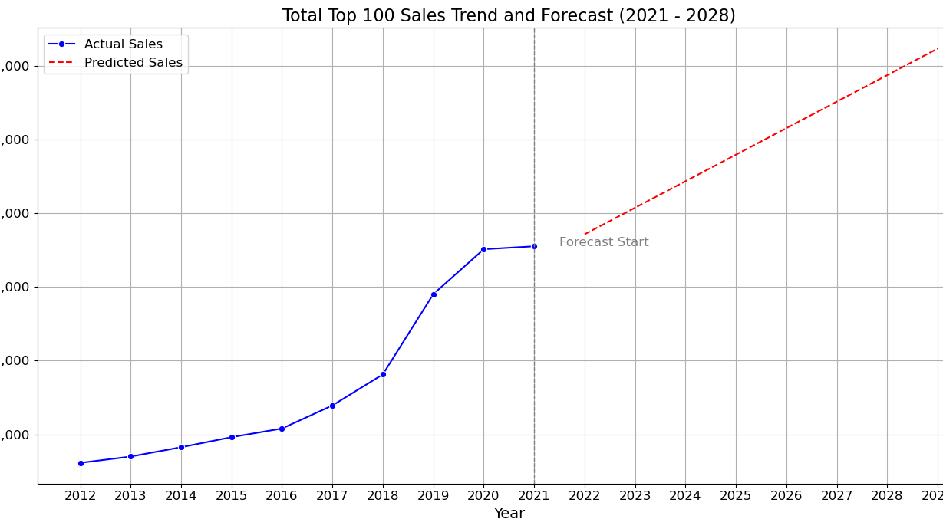
Embrace a Future of Growth
As we navigate past the disruptions caused by the pandemic, let's recognize that the growth we've anticipated has not vanished—it's merely been postponed. With the situation improving, we're on the cusp of realizing the deferred potential. Hold fast to confidence—the growth will materialize, and the opportunities ahead are ours to seize.

Slide 21
Thank you

